Slide 1
Year 11 Matters
Information Evening
Thursday 23rd October
4:00-6:00pm
Notes:
---

Slide 2
Time
After half term, there are only 21 school weeks left before the GCSE and BTEC exams begin.
First mock exam Friday 21st November
That means that there are only around 105 days of learning left before the exams.

Slide 3
Year 11 Expectations
Attendance & Punctuality- be here to reduce the learning gaps. This includes study support sessions too. Lateness means you miss vital instructions at the start. Attend more = achieve more.
Consistent Effort and Organisation- attend all lessons and engage in your learning. We are not prepared to accept passive learning. Complete all homework. If anything missed, students will need to catch up. Use your Teams sites when working independently and at home. Act on your mock exam feedback.
Meeting deadlines- weekly homework (minimum of 1- 2 hours per night) and internal assessments. Missing these not only affects grades but also builds poor habits.
Revision Routine- start early and reduce last minute stress.

Slide 4
WHY ACADEMIC SUCCESS MATTERS
Improved career opportunities- many employers use GCSE results as a minimum requirement, especially for apprenticeships or entry-level jobs
Access to sixth form/college- sixth forms and colleges require specific GCSE grades to enrol onto Level 3 A-levels or vocational courses – all will ask for passes in English and Maths.
Greater earning potential- research shows that students with higher GCSE grades tend to earn more over their lifetime compared to those with fewer qualifications.

Slide 5
ImportanCe of English & Maths
Minimum requirement of a grade 4 at GCSE for English and Maths
Your child will have to resit this at 6th form/college alongside their other subjects if they have not achieved at least a grade 4.
Course entry requirements for most 6th forms/colleges
Your child will need at least a grade 4 and/or grade 5 to access courses. For example at SCA, Science courses require a GCSE grade 6 in Maths due to the complex mathematical content of the course.
Grade
1 | Lowest grade
2
3
4 | Standard Pass
5 | Strong Pass
6
7
8
9 | Top grade

Slide 6
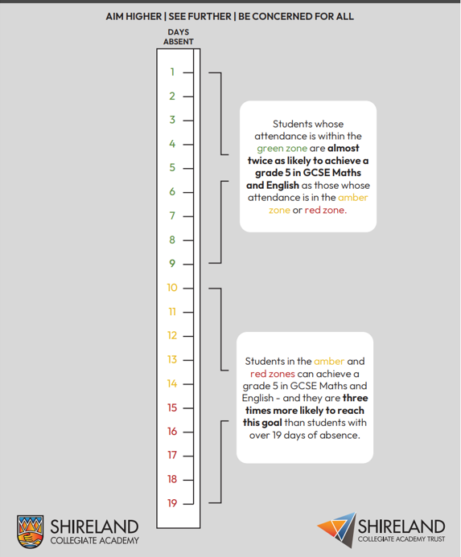
Attendance
Green area:
75-80% of students
pass English and Maths
Our Academy target for attendance is 95%
Less than 90% attendance (19 days off) means you reduce the chances of passing subjects – especially English and Maths.
Red area: fewer than 60% of students pass English and Maths

Slide 7
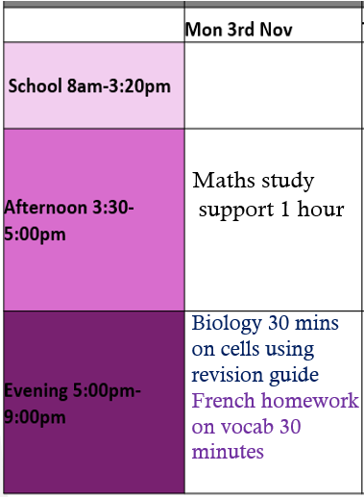
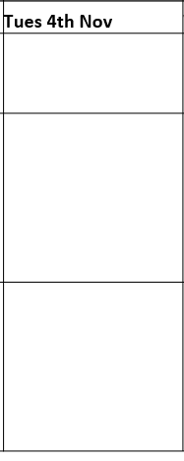
Preparation and revision for exams:
Mock exams Begin 21st November – 4 weeks away
Start early and plan ahead- create a revision timetable. Plan your subjects across a week.
Recommended 90 minutes of revision 5 days per week.
Recommended: 3 x 30 minutes minimum
of Maths and English each per week.
Keep your revision active! Use a range of strategies:
Review your notes
Make flashcards
Watch tutorial videos
Use online programmes – eg Dr Frost, Seneca
Create mindmaps
Attempt practice exam questions
Geography 30 mins volcanoes using notes
Maths 30 mins factorising Dr Frost
Physics 30mins atomic structure flashcards
RE homework essay completion 30 mins

Slide 8

How to support your child
When a flower doesn’t bloom, you fix the environment in which it grows, not the flower."
— Alexander Den Heijer
Quiet and dedicated study space- improves focus and study time. Monitor devices.
Make sure basic needs are met- eating healthy, sleeping and exercise
Focus on their effort, not just outcomes- celebrate small wins e.g doing a paper well and keep encouragement up
Regular checking in- ask what homework or revision they are doing
Priorities- put their studies first this year, they have one chance at this

Slide 9
Study support/BTEC Resit route
 | Monday | Tuesday | Wednesday | Thursday | Friday
Week A | Maths |  | Maths-Tute online English | Science | German
Week B | BTEC Resit route: IT Music Business Computer Science Dance Product Design |  | Maths- Tute online English (small group) Drama Geography History 1 RE German/Spanish/ French Art/Textiles Business 2 | BTEC Resit route: Health & Social Care PE (Comp 1&2) History 2 | BTEC Resit route: Travel & Tourism Music GCSE German
Week A- 1st Sept, 15th Sept, 29th Sept, 13th Oct, 3rd Nov, 17th Nov, 1st Dec, 15th Dec
Week B- 8th Sept, 22nd Sept, 6th Oct, 20th Oct, 10th Nov, 24th Nov, 8th Dec
Library is open during lunch times and after school
(Monday, Weds, Thurs)

Slide 10
Monday 27th October- Half Term Study Support
9:30- 12:00 Maths (selected students)
12:30-3:00 BTECs- ICT, Health & Social Care and PE

Slide 11
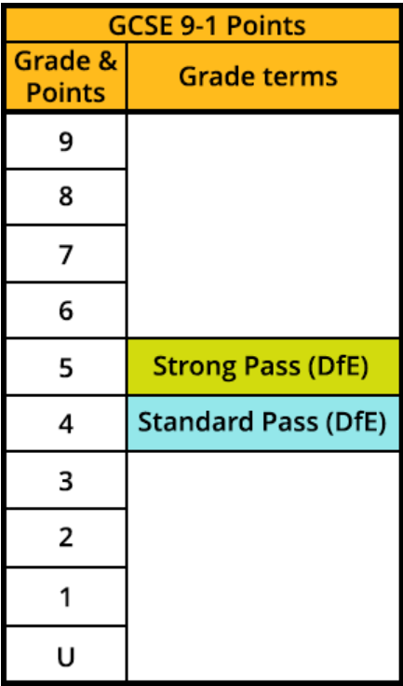
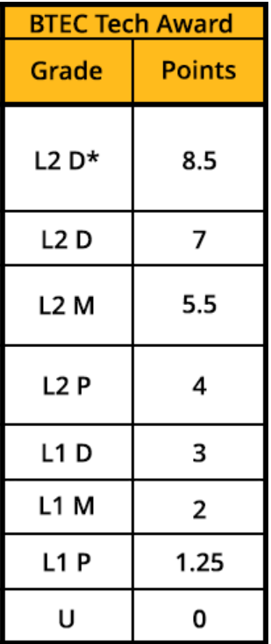
Resit Route – BTEC Subjects
As a result of underperforming in 1 or more components in Year 10 your child might be on a resit route.
Week B study support timetable (one hour every other week).
This is a session for them to complete resit coursework in exam accounts.
A letter on Arbor.
Once the resit is complete, they will be removed from the resit route and no longer required to attend.
An improvement in one component can make a huge difference to their overall grade.
Component 1 (30%)
Component 2 (30%)
Component 3 (40%)
Overall Grade

Slide 12

Post 16 Open Evening- Thursday 13th November

Slide 13
Speak to our heads of departments tonight!
In the Sports Hall are our Heads of Department and some successful former students.
Ask them any subject related questions that you might have.
They are here to share their top tips - how to be successful in their subject.
Revision guides ordering opportunity- order can be made from the school by completing online form.
There are staff who can any specific questions you might have regarding SEND, Exam stress, careers, or for our Exams Officer.

Slide 14
Questions You Have asked:
How can my child revise?
Revision timetable, chunking revision up, be active in revision, speak to subject staff
When does my child get their exam timetable?
Emailed to student 3 weeks before mock period
Summer exam timetable- personalised timetables given in April 2026
When is the last exam?
Your child will officially have no exams after Wednesday 24th June 2026
What if I want to know about how my child is getting on in certain subjects?
You now have access to Assessment Point 1 data via Arbor (ask staff in the Sports Hall if you need help accessing or understanding this).
Parents evening in early January for your opportunity to speak to your child's class teachers.
Contact the Head of Department or teacher via their form tutor or calling our Reception admin team.
What if my child’s teacher is absent?
Head of Department will ensure appropriate cover work is set. Utilise online resources to support students. Exam classes are prioritised with staff covering.

